Slide 1
Composition
Sayan Mitra
Verifying cyberphysical systems
mitras@illinois.edu

Slide 2
HW3 out
Read chapter 5

Slide 3
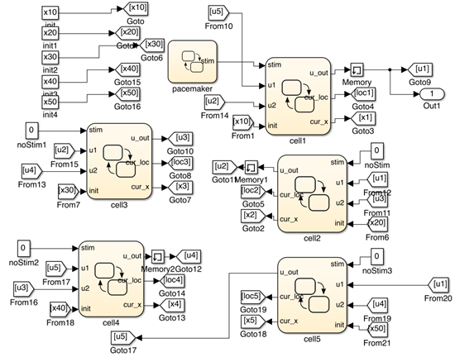
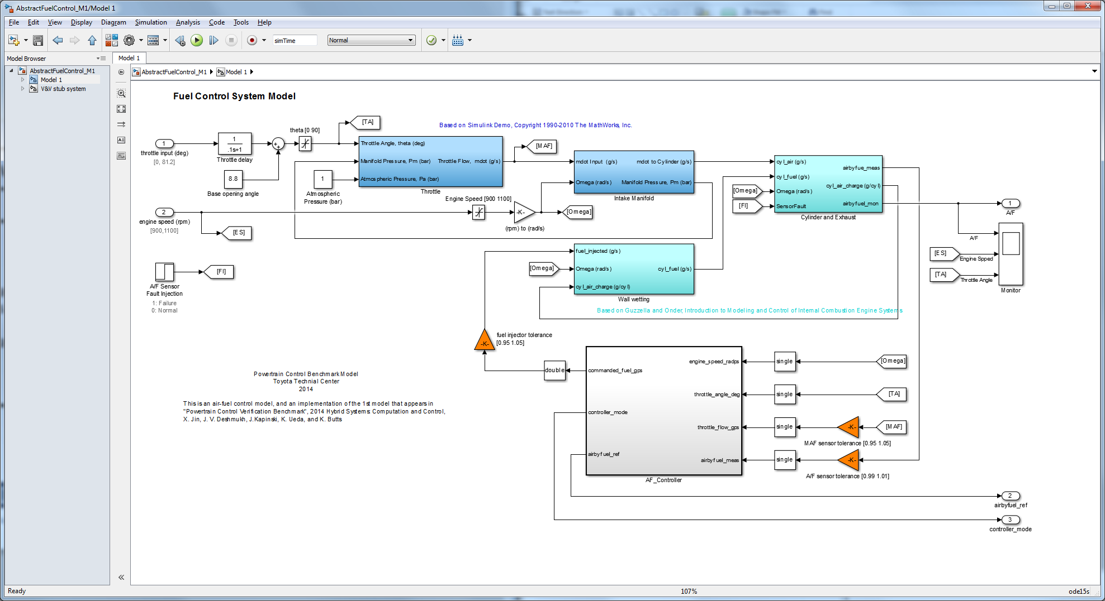
What is composition?
Complex models and systems are built by putting together components or modules
Composition is the mathematical operation of putting together
Leads to precise definition of module interfaces
What properties are preserved under composition?
model of a network of oscillators [Huang et. al 14]
Powertrain model from Toyota [Jin et al. 15]

Slide 4
Give an example of how you’ve built something more complex from simple components
Throughout the lecture, think if your notion of composition is captured by what we define

Slide 5
Outline
Composition operation
Input/output interfaces
I/O automata
hybrid I/O automata
Examples
Properties of composition

Slide 6
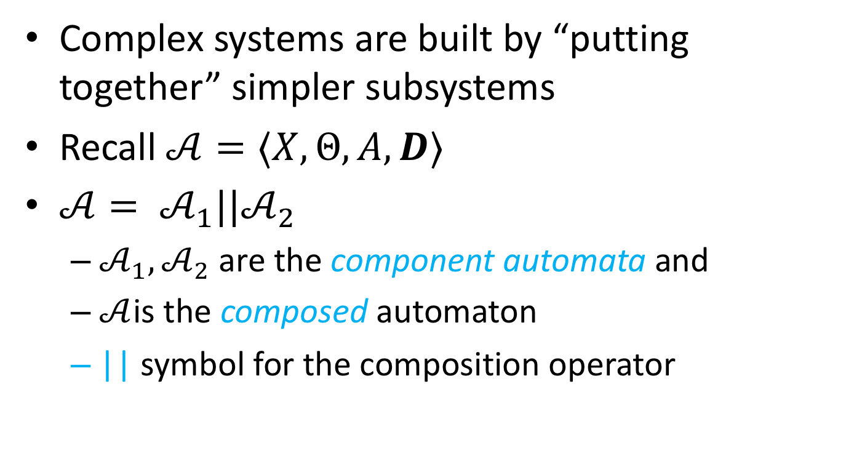
Composition of automata
Complex systems are built by “putting together” simpler subsystems
Recall $𝒜=⟨X,Θ,A, D⟩$
$𝒜= 𝒜_{1}||𝒜_{2}$
$𝒜_{1}, 𝒜_{2}$ are the component automata and
$𝒜$is the composed automaton
|| symbol for the composition operator

Slide 7
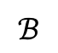

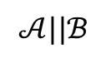
Composition: asynchronous modules
$$𝒜||ℬ$$
$$𝒜$$
$$ℬ$$
a
d
a
d
b
d
a
e
b
e
c
d
b
e
a
f
c
e
b
f
c
f
c
f

Slide 8

composition: modules synchronize
$$𝒜$$
$$ℬ$$
a
d
a
d
b
d
a
e
b
e
c
d
b
e
a
f
c
e
b
f
c
f
c
f

Slide 9
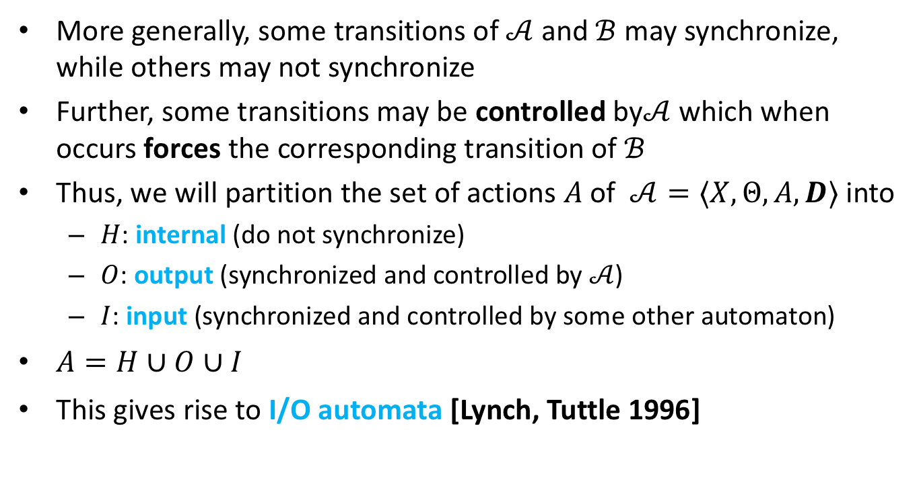
Composition of (discrete) automata
More generally, some transitions of $𝒜$ and $ℬ$ may synchronize, while others may not synchronize
Further, some transitions may be controlled by$𝒜$ which when occurs forces the corresponding transition of $ℬ$
Thus, we will partition the set of actions $A$of $𝒜=⟨X,Θ,A, D⟩$ into
$H$: internal (do not synchronize)
$O$: output (synchronized and controlled by $𝒜$)
$I$: input (synchronized and controlled by some other automaton)
$A=H∪O∪I$
This gives rise to I/O automata [Lynch, Tuttle 1996]

Slide 10
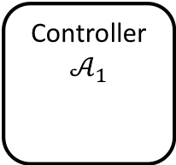
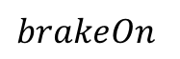
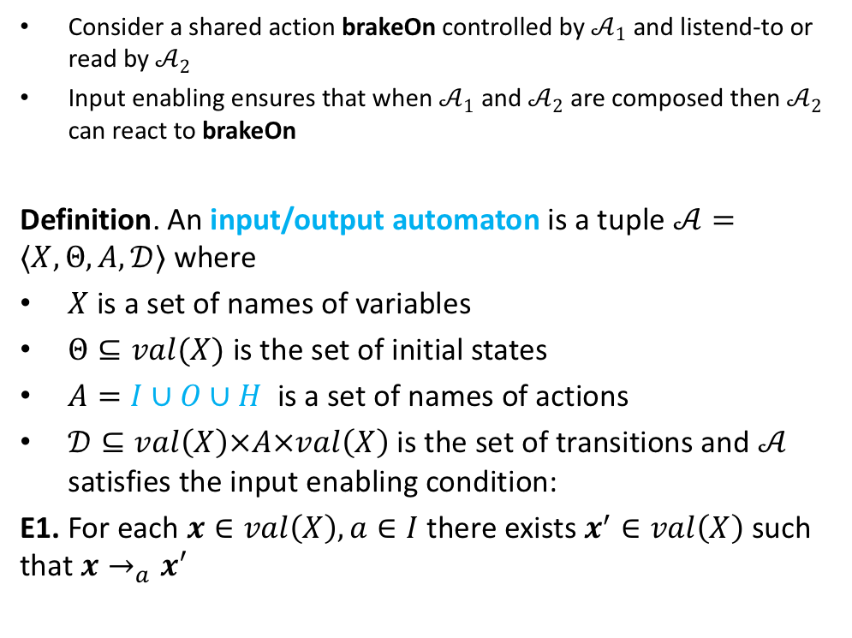
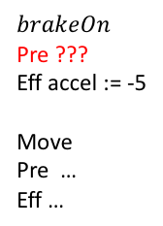
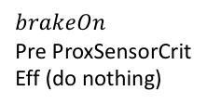
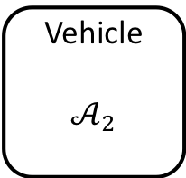
Reactivity: Input enabling
Consider a shared action brakeOn controlled by $𝒜_{1}$ and listend-to or read by $𝒜_{2}$
Input enabling ensures that when $𝒜_{1}$ and $𝒜_{2}$ are composed then $𝒜_{2}$ can react to brakeOn
Definition. An input/output automaton is a tuple $𝒜=〈X,Θ, A, 𝒟〉$ where
$X$ is a set of names of variables
$Θ⊆val(X)$ is the set of initial states
$A=I∪O∪H$ is a set of names of actions
$𝒟⊆val\left(X\right)×A×val\left(X\right)$ is the set of transitions and $𝒜$ satisfies the input enabling condition:
E1. For each $x∈val\left(X\right), a∈I$ there exists $x^{′}∈val\left(X\right)$ such that $x→_{a}x′$
Controller
$$𝒜_{1}$$
$$brakeOn$$
Pre ProxSensorCrit
Eff (do nothing)
$$brakeOn$$
Vehicle
$$𝒜_{2}$$
$$brakeOn$$
Pre ???
Eff accel := -5
Move
Pre …
Eff …

Slide 11
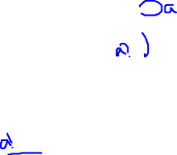
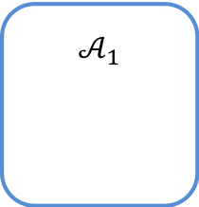
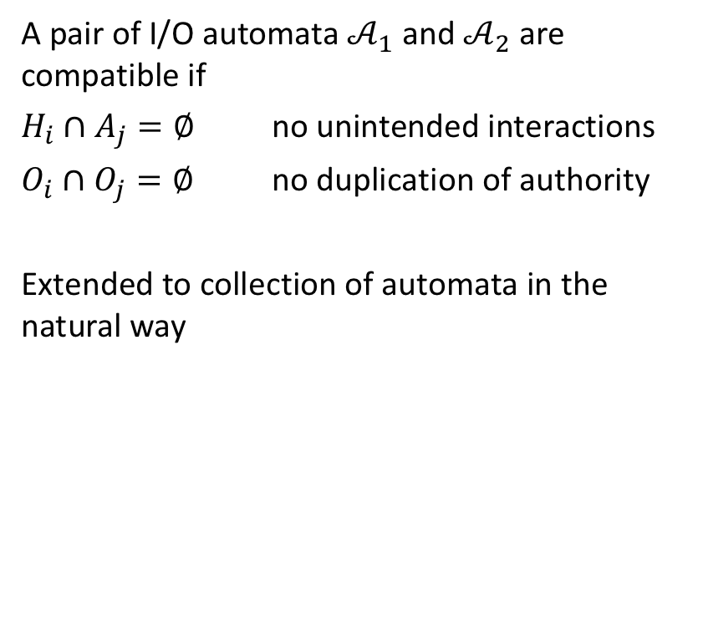
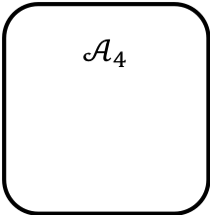
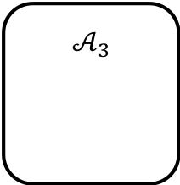
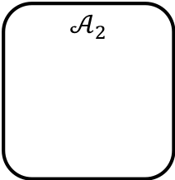
Compatibility IOA
$$𝒜_{1}$$
a
A pair of I/O automata $𝒜_{1}$ and $𝒜_{2}$ are compatible if
$H_{i}∩A_{j}=∅$ no unintended interactions
$O_{i}∩O_{j}=∅$ no duplication of authority
Extended to collection of automata in the natural way
b
c
$$𝒜_{2}$$
$$𝒜_{3}$$
d
e
f
$$𝒜_{4}$$

Slide 12
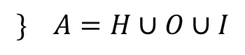
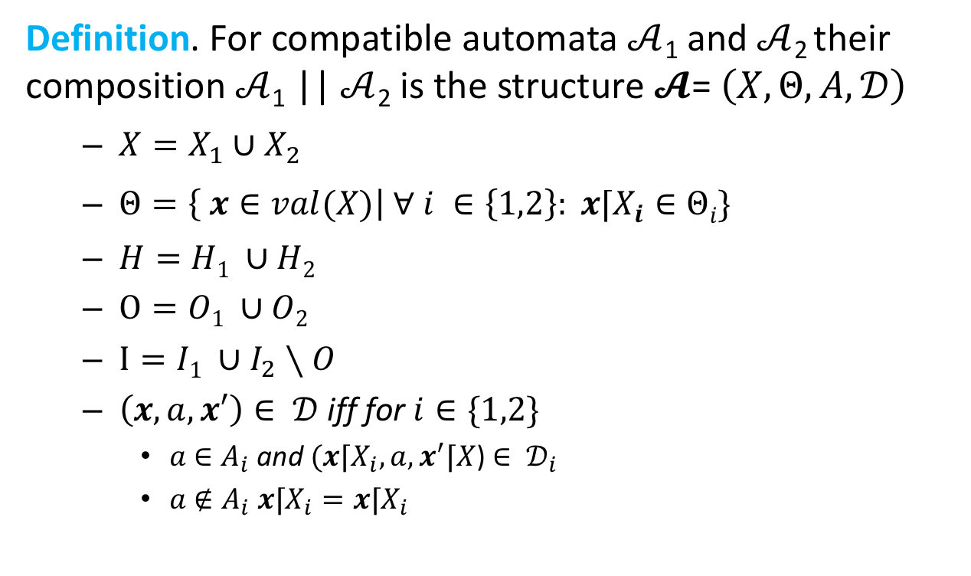
Composition of I/O automaton
Definition. For compatible automata $𝒜$₁ and $𝒜$₂ their composition $𝒜$₁ || $𝒜$₂ is the structure $𝓐$= $\left(X,Θ,A,𝒟\right)$
$X=X_{1}∪X_{2}$
$Θ=\left\{ x∈val(X)\right| ∀ i ∈\left\{1,2\right\}: x⌈X_{i}∈Θi\}$
$H=H1 ∪H2$
$O=O1 ∪O2$
$I=I1 ∪I_{2}∖O$
$\left(x,a,x′\right)∈ 𝒟$ iff for $i∈\{1,2\}$
$a$ $∈A_{i}$ and $(x⌈X_{i},a,x^{′}⌈X$) $∈ 𝒟_{i}$
$a$ $∉A_{i}$ $x⌈X_{i}=x⌈X_{i}$
$$\} A=H∪O∪I$$

Slide 13
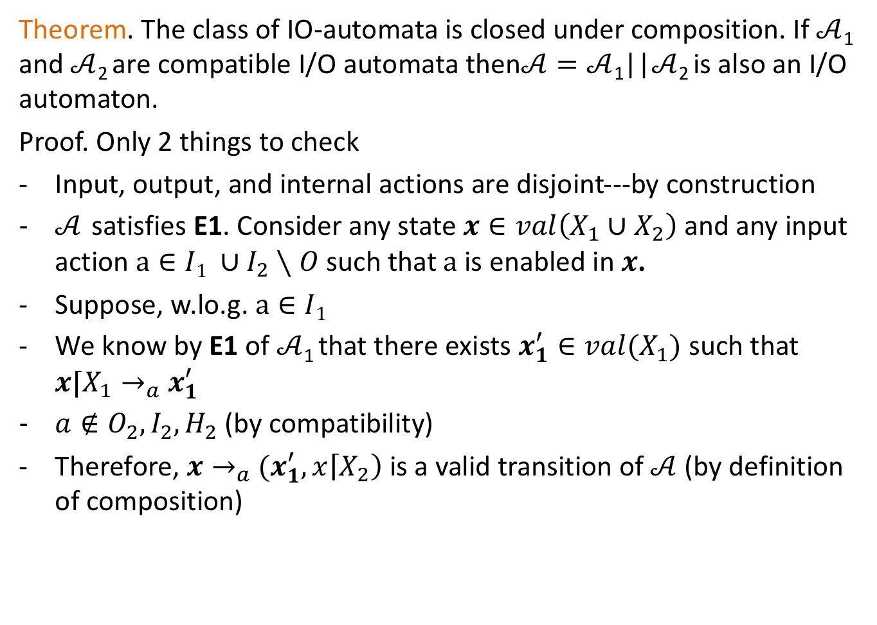
Theorem. The class of IO-automata is closed under composition. If $𝒜$₁ and $𝒜$₂ are compatible I/O automata then$𝒜=𝒜$₁||$𝒜$₂ is also an I/O automaton.
Proof. Only 2 things to check
Input, output, and internal actions are disjoint---by construction
$𝒜$ satisfies E1. Consider any state $x∈val\left(X_{1}∪X_{2}\right)$ and any input action$a∈I1 ∪I_{2}∖O$ such that $a$is enabled in $x$.
Suppose, w.lo.g. $a∈I1$
We know by E1 of $𝒜$₁ that there exists $x_{1}^{′}∈val(X_{1})$ such that $x⌈X_{1}→_{a}$ $x_{1}^{′}$
$a∉O_{2},I_{2},H_{2}$ (by compatibility)
Therefore, $x→_{a}$ $(x_{1}^{′},x\left\lceil X_{2}\right)$ is a valid transition of $𝒜$ (by definition of composition)

Slide 14
Example: Sending process and channel
System
Sender
Channel
Receiver
fail
send(m)
receive(m)
send(m)
~failed
Automaton Sender(u)
variables internal
failed:Boolean := F
output send(m:M)
input fail
transitions:
output send(m)
pre ~failed
eff
input fail
pre true
eff failed := T
Loc 1
failed
fail
true
failed := T

Slide 15
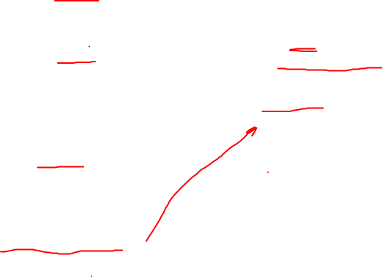
FIFO channel & Simple Failure Detector
Automaton Sender(u)
variables internal
failed:Boolean := F
output send(m:M)
input fail
transitions:
output send(m)
pre ~failed
eff
input fail
pre true
eff failed := T
Automaton System(M)
variables queue: Queue[M] := {}, failed: Bool
actions input fail
output send(m:M), receive(m:M)
transitions:
output send(m)
pre ~failed
eff queue := append(m, queue)
output receive(m)
pre head(queue)=m
eff queue := queue.tail
input fail
pre true
eff failed := true
Automaton Channel(M)
variables internal queue: Queue[M] := {}
actions input send(m:M)
output receive(m:M)
transitions:
input send(m)
pre true
eff queue := append(m, queue)
output receive(m)
pre head(queue)=m
eff queue := queue.tail

Slide 16
composing hybrid systems

Slide 17
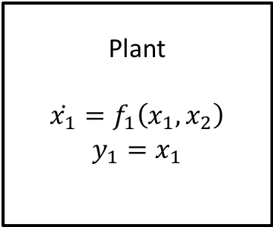
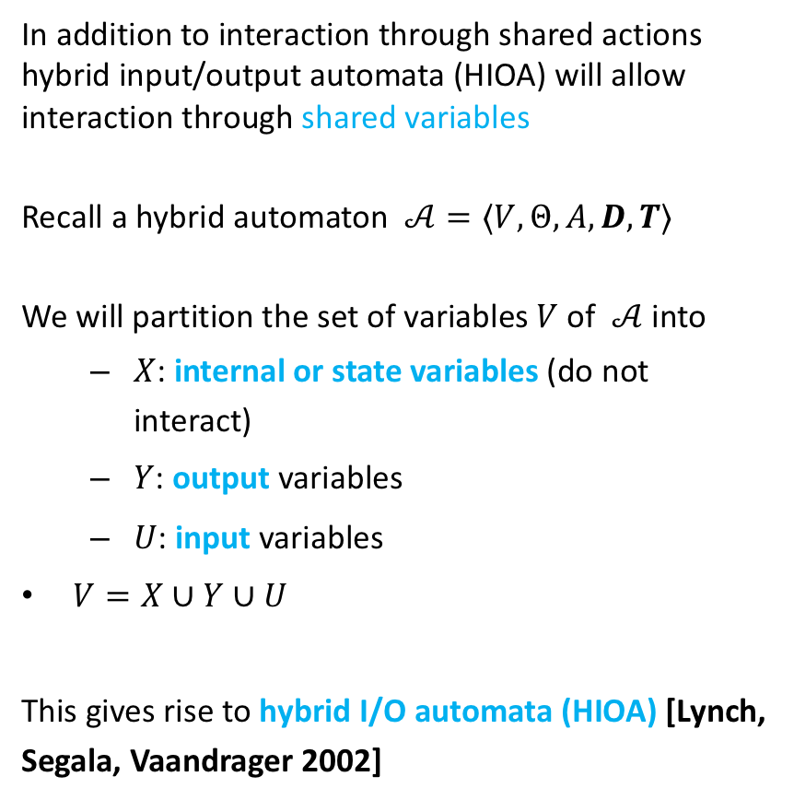
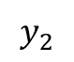
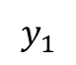
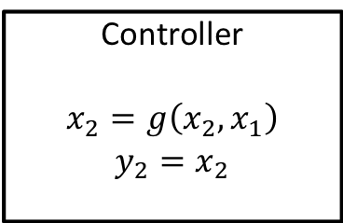
Hybrid IO Automaton
In addition to interaction through shared actions hybrid input/output automata (HIOA) will allow interaction through shared variables
Recall a hybrid automaton $𝒜=⟨V,Θ,A, D,T⟩$
We will partition the set of variables $V$of $𝒜$ into
$X$: internal or state variables (do not interact)
$Y$: output variables
$U$: input variables
$V=X∪Y∪U$
This gives rise to hybrid I/O automata (HIOA) [Lynch, Segala, Vaandrager 2002]
Plant
$$\dot{x_{1}}=f_{1}\left(x_{1},x_{2}\right)$$
$$y_{1}=x_{1}$$
$$y_{2}$$
$$y_{1}$$
Controller
$$x_{2}=g\left(x_{2},x_{1}\right)$$
$$y_{2}=x_{2}$$

Slide 18
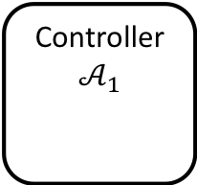
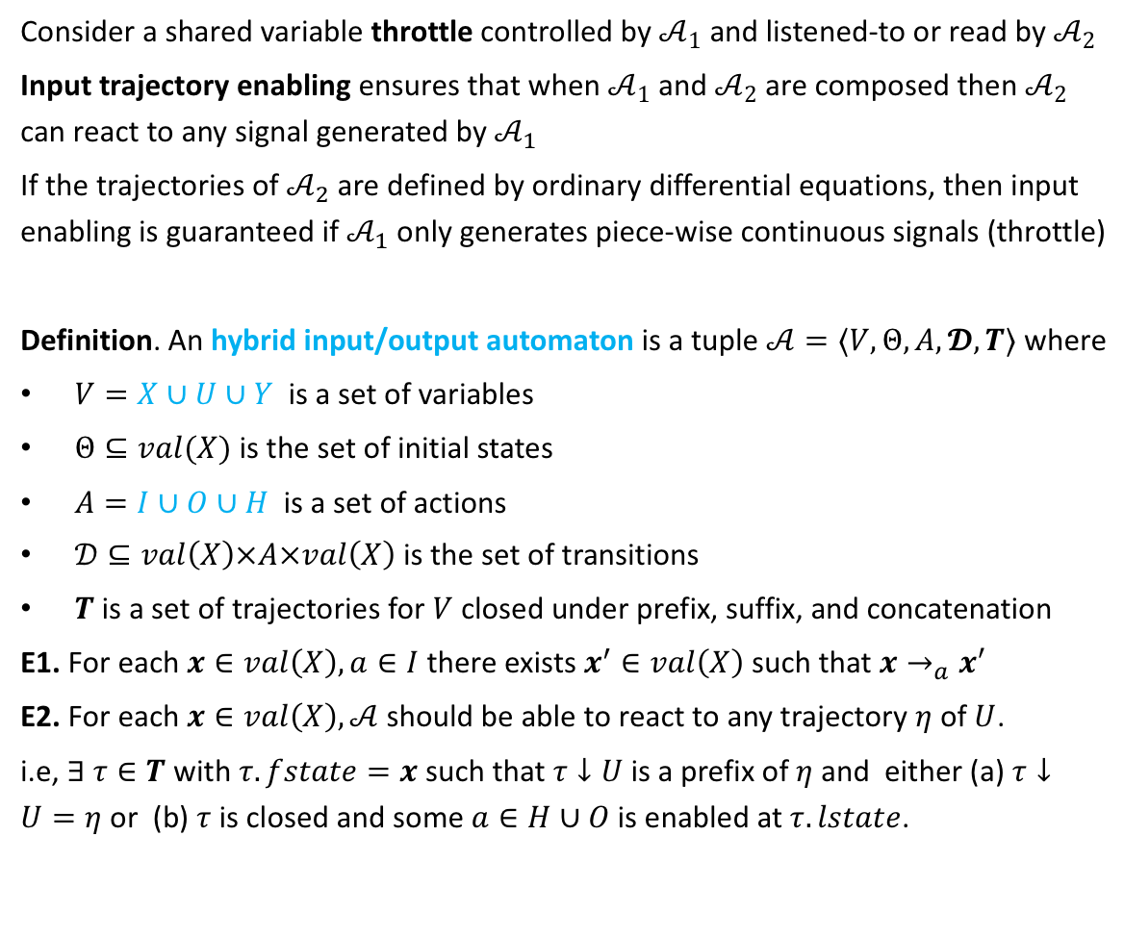
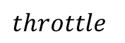

Reactivity: Input trajectory enabling
Consider a shared variable throttle controlled by $𝒜_{1}$ and listened-to or read by $𝒜_{2}$
Input trajectory enabling ensures that when $𝒜_{1}$ and $𝒜_{2}$ are composed then $𝒜_{2}$ can react to any signal generated by $𝒜_{1}$
If the trajectories of $𝒜_{2}$ are defined by ordinary differential equations, then input enabling is guaranteed if $𝒜_{1}$ only generates piece-wise continuous signals (throttle)
Definition. An hybrid input/output automaton is a tuple $𝒜=〈V,Θ, A, 𝓓,T〉$ where
$V=X∪U∪Y$ is a set of variables
$Θ⊆val(X)$ is the set of initial states
$A=I∪O∪H$ is a set of actions
$𝒟⊆val\left(X\right)×A×val\left(X\right)$ is the set of transitions
$T$ is a set of trajectories for $V$ closed under prefix, suffix, and concatenation
E1. For each $x∈val\left(X\right), a∈I$ there exists $x^{′}∈val\left(X\right)$ such that $x→_{a}x′$
E2. For each $x∈val\left(X\right), 𝒜$should be able to react to any trajectory $η$ of $U$.
i.e, $∃ τ∈T$ with $τ.fstate=x$such that $τ↓U$is a prefix of $η$ and either (a) $τ↓U=η$ or (b) $τ$ is closed and some $a∈H∪O$is enabled at $τ.lstate$.
Controller
$$𝒜_{1}$$
$$throttle$$
Vehicle
$$𝒜_{2}$$

Slide 19
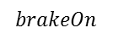
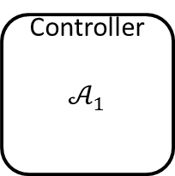
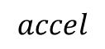
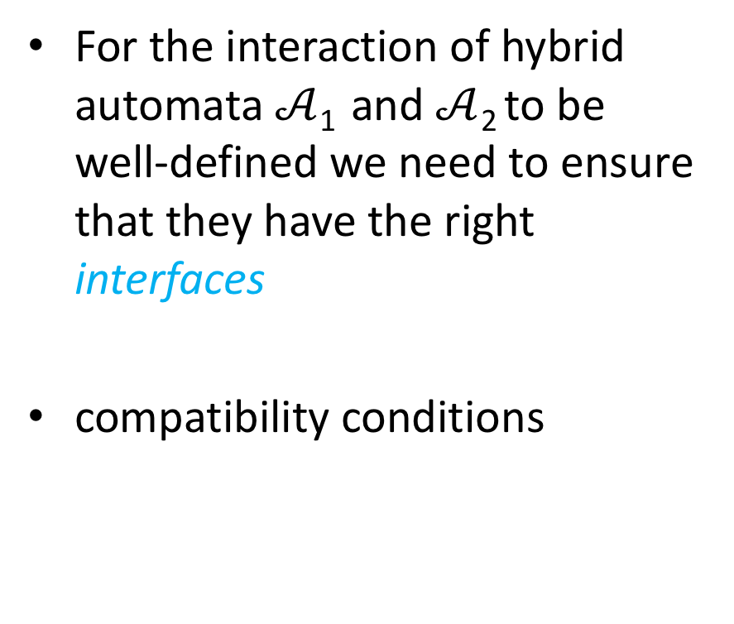
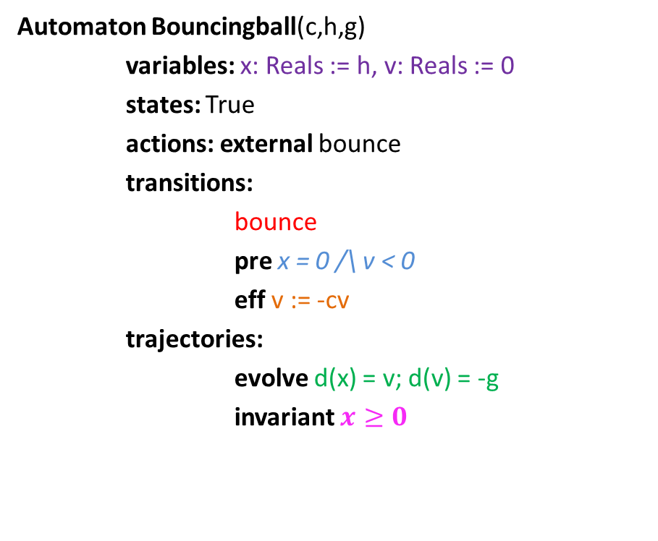
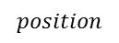
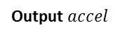
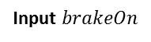
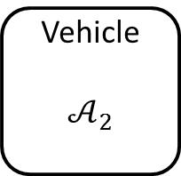
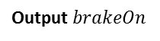
Compatibility of hybrid automata
For the interaction of hybrid automata $𝒜$₁ and $𝒜$₂ to be well-defined we need to ensure that they have the right interfaces
compatibility conditions
Controller
$$𝒜_{1}$$
$$accel$$
Vehicle
$$𝒜_{2}$$
Output $accel$
Input $accel$
$$brakeOn$$
Output $brakeOn$
Input $brakeOn$
$$position$$

Slide 20
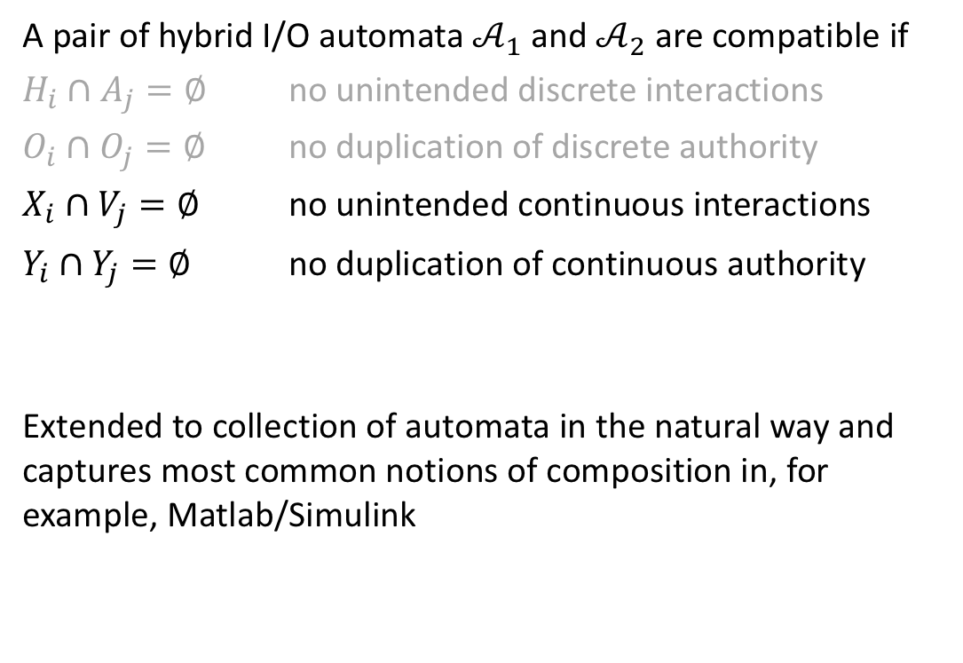
Compatibility HIOA
A pair of hybrid I/O automata $𝒜_{1}$ and $𝒜_{2}$ are compatible if
$H_{i}∩A_{j}=∅$ no unintended discrete interactions
$O_{i}∩O_{j}=∅$ no duplication of discrete authority
$X_{i}∩V_{j}=∅$ no unintended continuous interactions
$Y_{i}∩Y_{j}=∅$ no duplication of continuous authority
Extended to collection of automata in the natural way and captures most common notions of composition in, for example, Matlab/Simulink

Slide 21
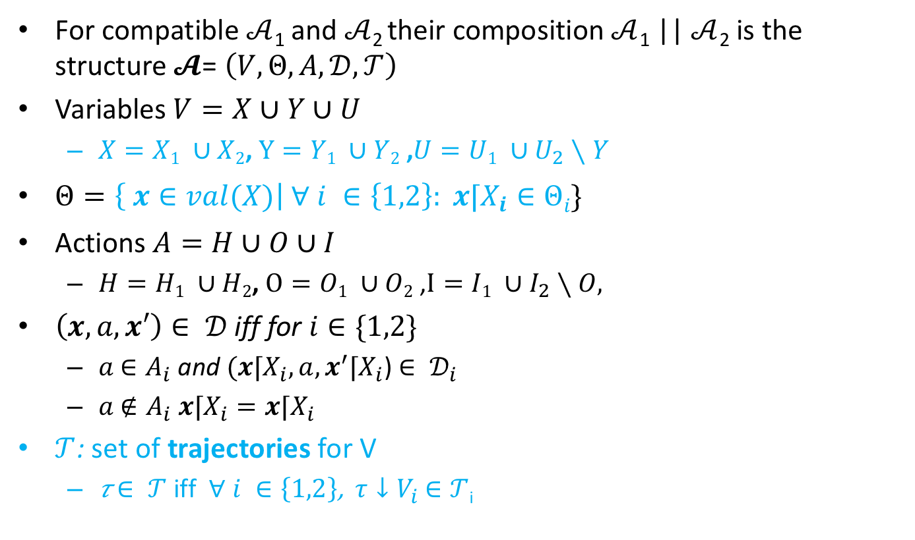
Composition
For compatible $𝒜$₁ and $𝒜$₂ their composition $𝒜$₁ || $𝒜$₂ is the structure $𝓐$= $\left(V,Θ,A,𝒟,𝒯\right)$
Variables $V=X∪Y∪U$
$X=X1 ∪X2$, $Y=Y1 ∪Y2$ ,$U=U1 ∪U_{2}∖Y$
$Θ=\left\{ x∈val(X)\right| ∀ i ∈\left\{1,2\right\}: x⌈X_{i}∈Θi\}$
Actions $A=H∪O∪I$
$H=H1 ∪H2$, $O=O1 ∪O2$ ,$I=I1 ∪I_{2}∖O,$
$\left(x,a,x′\right)∈ 𝒟$ iff for $i∈\{1,2\}$
$a$ $∈A_{i}$ and $(x⌈X_{i},a,x^{′}⌈X_{i}$) $∈ 𝒟_{i}$
$a$ $∉A_{i}$ $x⌈X_{i}=x⌈X_{i}$
$𝒯$: set of trajectories for V
𝜏 $∈ 𝒯$ iff $∀ i ∈\left\{1,2\right\}$, $τ↓V_{i}$ $∈𝒯$_{i}

Slide 22
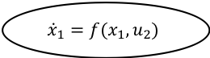
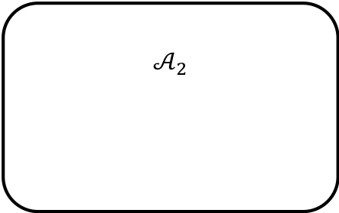
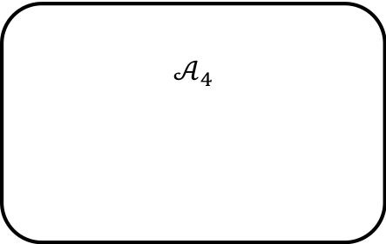
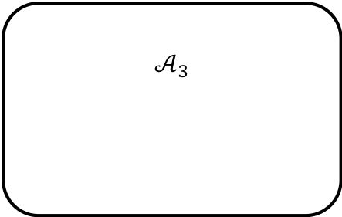
$$𝒜_{2}$$
u₂
u₂
$${\dot{x}}_{1}=f(x_{1},u_{2})$$
a₁
a₁
$$𝒜_{3}$$
a₁
e
e
f
f
a₁
$$𝒜_{4}$$

Slide 23
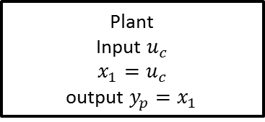
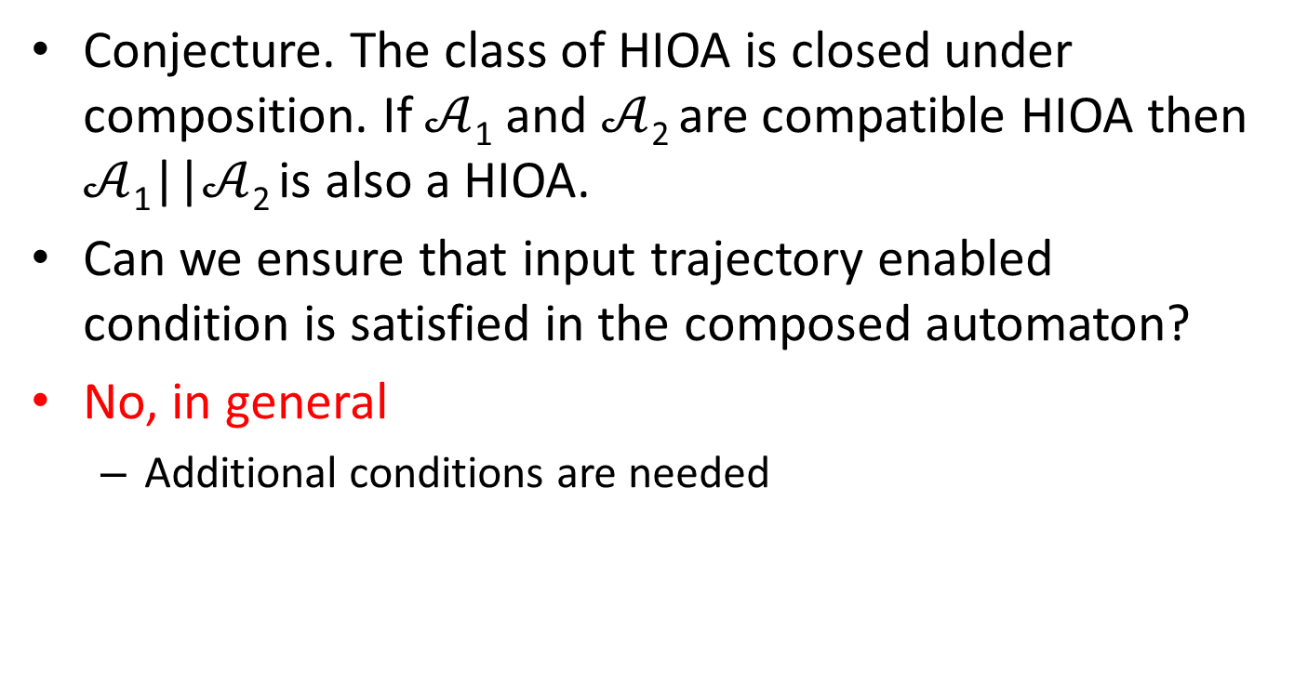
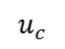
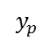

Closure under composition
Conjecture. The class of HIOA is closed under composition. If $𝒜$₁ and $𝒜$₂ are compatible HIOA then $𝒜$₁||$𝒜$₂ is also a HIOA.
Can we ensure that input trajectory enabled condition is satisfied in the composed automaton?
No, in general
Additional conditions are needed
Plant
Input $u_{c}$
$$x_{1}=u_{c}$$
output $y_{p}=x_{1}$
$$u_{c}$$
$$y_{p}$$
Controller
Input $y_{p}$
$$x_{2}=y_{p}+1$$
Output $u_{c}=x_{2}$

Slide 24





Hybrid IO Automaton
In addition to interaction through shared actions will allow interaction through shared variables
Set of variables partitioned as $V=X∪U∪$ Y
X: set of internal variables (not involved in interactions)
Y: set of output variables
U: set of input variables
Note. Given a trajectory of $u_{c}$, say $η$, and initial state $x_{0}, τ$ is a valid trajectory of $x_{1}$ if for all t
$\frac{d}{dt}\left(τ↓x_{1}\right)\left(t\right)=f_{1}(τ\left(t\right), η\left(t\right))$ and
$τ\left(0\right)=x_{0}$
Plant
Input $u_{c}$
$$\dot{x_{1}}=f_{1}\left(x_{1},u_{c}\right)$$
output $y_{p}=x_{1}$
$$u_{c}$$
$$y_{p}$$
Controller
Input $y_{p}$
$$x_{2}=g\left(x_{2},y_{1}\right)$$
Output $u_{c}=x_{2}$

Slide 25


Example 2: Periodically Sending Process
Automaton PeriodicSend(u)
variables internal
clock: Reals := 0, z:Reals, failed:Boolean := F
signature output send(m:Reals)
input fail
transitions:
output send(m)
pre clock = u /\ m = z /\ ~failed
eff clock := 0
input fail
pre true
eff failed := T
trajectories:
evolve d(clock) = 1, d(z) = f(z)
invariant failed \/ clock$≤$u
send(m)
clock = u /\ m = z /\ ~failed
clock := 0
Loc 1
$$d\left(clock\right)=1$$
$$d\left(z\right)=f(z)$$
~failed$⇒clock≤u$
clock:= 0
fail
true
failed := T

Slide 26


Time bounded channel & Simple Failure Detector
Automaton Timeout(u,M)
variables: suspected: Boolean := F,
clock: Reals := 0
signature input receive(m:M)
output timeout
transitions:
input receive(m)
pre true
eff clock := 0; suspected := false;
output timeout
pre ~suspected /\ clock = u
eff suspected := true
trajectories:
evolve d(clock) = 1
invariant clock $≤$ u \/ suspected
Automaton Channel(b,M)
variables internal queue: Queue[M,Reals] := {}
clock: Reals := 0
signature input send(m:M)
output receive(m:M)
transitions:
input send(m)
pre true
eff queue := append(<m, clock+b>, queue)
output receive(m)
pre head(queue)[1]=m $∧$
head(queue)[2]=clock
eff queue := queue.tail
trajectories:
evolve d(clock) = 1
invariant $∀$<m,d>∈ queue: d $≥$ clock

Slide 27
Example 3: Oscillator and pulse generator
pulseGen
Oscillator

Slide 28




Composed automaton
On,Mode
$$d\left(now\right)=1$$
$$d\left(x_{1}\right)=−x_{1}\left(x_{1}^{2}+0.9x_{1}+0.9\right)−x_{2}+1$$
$$d\left(x_{2}\right)=x_{1}−2x_{2}$$
$$now≤T_{On}$$
Oscillator1
pre:$now≥T_{Off}$
eff: $now≔0$
pre:$now≥T_{On}$
eff: $now≔0$
Oscillator6
Oscillator2
pulseGen
Off,Mode
$$d\left(now\right)=1$$
$$d\left(x_{1}\right)=−x_{1}\left(x_{1}^{2}+0.9x_{1}+0.9\right)−x_{2}+0$$
$$d\left(x_{2}\right)=x_{1}−2x_{2}$$
$$now≤T_{Off}$$
Oscillator5
Oscillator3
Oscillator4
Cardiac oscillator network models, Grosu et al. CAV, HSCC 2007-2015

Slide 29

Restriction operation on exections
Sometimes it is useful to restrict our attention to only some subset of variables and actions in an execution
Recall the restriction operations $x⌈V and τ↓V$
Let $α=τ_{0}a_{1}τ_{1}a_{2}$ be an execution fragment of a hybrid automaton with set of variables $V$ and set of actions $A$. Let $A′$ be a set of actions and $V′$ be a set of variables.
Restriction of $α$to $(A′,V′)$, written as $α⌈(A′, V′)$ is the sequence defined inductively as:
$α⌈\left(A^{′},V^{′}\right)$ = $τ↓V^{′}$ if $α=τ$
$α a τ ⌈\left(A^{′},V^{′}\right)$ =
$α ⌈\left(A^{′},V^{′}\right) a (τ↓V^{′})$ if $a∈A′$
$α ⌈\left(A^{′},V^{′}\right) concat (τ↓V^{′})$ if $a∉A^{′}$
From the definition it follows $α.lstate ⌈V^{′}=α⌈\left(A′,V^{′}\right).lstate$ for any $A^{′},V′$

Slide 30

Properties of Compositions
Proposition. Let $𝒜= 𝒜_{1}||𝒜_{2}$. $α$ is an execution fragment of $𝒜$ iff
$α⌈\left(A_{i},V_{i}\right), i∈\left\{1,2\right\}$ are both execution fragments of $𝒜_{i}.$
Proof of the forward direction. Fix $α$ and i. We prove this by induction on the length of $α.$
Base case: $α=τ.$ $α⌈\left(A_{i},V_{i}\right)=τ↓V_{i}$ by definition of composition $τ↓V_{i}∈T_{i}$. So, $τ↓V_{i}∈Frag_{i}$
$α=α′ a τ ⌈\left(A_{i},V_{i}\right)$ and $a∈A_{i}$ and by induction hypothesis $α′⌈\left(A_{i},V_{i}\right)∈Frag_{i}$. Let $α′⌈\left(A_{i},V_{i}\right).lstate$= $v.$ By the definition of composition: $τ↓V_{i}∈T_{i}$.
It remains to show that $v⌈V_{i}→_{a}\left(τ↓V_{i}\right).fstate.$Since $a∈A_{i},$by the definition of composition: $α′⌈\left(A_{i},V_{i}\right).lstate →_{a}τ↓V_{i}.fstate$
$α=α′ a τ ⌈\left(A_{i},V_{i}\right)$ and $a∉A_{i}$ and by induction hypothesis $α′⌈\left(A_{i},V_{i}\right)∈Exec_{i}.$Let $τ′$ be the last trajectory in that execution.
Since $a∉A_{i},$by the definition of composition:$τ^{′}.lstate=τ↓V_{i}.fstate$. By concatenation closure of $Τ_{i}$, it follows that $τ^{′}concat τ↓V_{i}∈Τ_{i}.$ Therefore $α⌈\left(A_{i}, V_{i}\right)∈Exec_{i}$.
Notes:
Fix 1.

Slide 31

properties of executions of composed automata
$α$ is an execution iff $α⌈\left(A_{i},V_{i}\right), i∈\left\{1,2\right\}$ are both executions.
$α$ is time bounded iff $α⌈\left(A_{i},V_{i}\right), i∈\left\{1,2\right\}$ are both time bounded.
$α$ is admissible iff $α⌈\left(A_{i},V_{i}\right), i∈\left\{1,2\right\}$ are both admissible.
$α$ is closed iff $α⌈\left(A_{i},V_{i}\right), i∈\left\{1,2\right\}$ are both closed.
$α$ is non-Zeno iff $α⌈\left(A_{i},V_{i}\right), i∈\left\{1,2\right\}$ are both time non-Zeno.

Slide 32
Summary
Composition operation
I/O interfaces: actions and variables
Reactivity/input enabling
(non) Closure under composition
Properties of executions preserved under composition
Inductive invariants

Slide 33

Example Inductive Invariance Proof
S: ∀ <m,d> ∈ x.queue: x.clock $≤$ d $≤$x.clock+b
Is an invariant for the timed channel.
Proof. Use the theorem.
Check start condition. Holds vacuously as x.queue = {} [Def of initial states]
Check trajectory condition. Consider any $τ,$let x = $τ$.fstate and x’ = $τ$.lstate and $τ$.ltime = t. Assume x satisfies (1) and show that x’ also.
x.queue = x’.queue [trajectory Def], Fix <m,d> in x.queue
x.clock ≤ d [By Assumption]
Suppose x’.clock > d
x’.clock - x.clock > d - x.clock
t > d - x.clock, then there exists t’ ∈ $τ$.dom and t’ < t where $τ$(t’).clock = d
By invariant $τ$.ltime = t’ which is a contradiction
Also, since d ≤ x.clock+b, d≤ x’.clock+t+b
Check transitions:
$x→_{receive(m)}x’$. Follows from assumption $x∈S$.
$x→_{send(m)}x’$ …

